Slide 1

Indoor Localization Robot

Slide 2
Introduction
Block diagram to be added

Slide 3

01
Web Application and Server

Slide 4
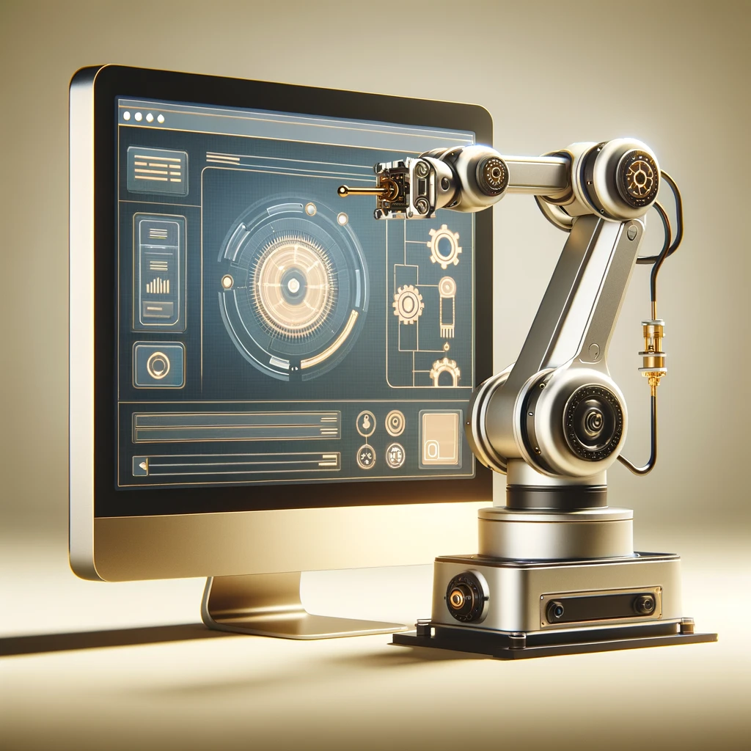
Why Web Application ?
Managing and controlling robotic tasks through an intuitive web interface.

Slide 5
Structure
Seamless interaction with robot and monitor performance.
Front-end
A robust architecture, integrating databases and server-side logic to handle real-time communication.
Back-end
Server
Running the dashboard and send data reliably to the robot using ROS scripts.

Slide 6





Technology Stack

Slide 7
Main Features
Flexibility in Adding Robots.
Creating Maps/Paths.
Creating and assigning tasks to robots.
Control robots with real-time data visualization.

Slide 8
02
Hardware

Slide 9
Guiding principles
Vision
Mission
To be able to provide a solid hardware infrastructure with relative ease.
In the end of the project, the infrastructure is designed to be:
Sourced locally.
Modular.
Open-Source.

Slide 10
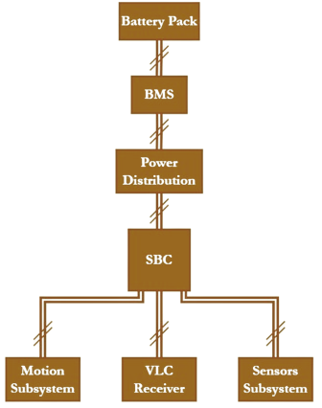
Robot Infra-structure:

Slide 11
Power Board:
Multiple Outputs for Power Distribution.
5V conversion, for powering the used SBC.
Reverse Polarity and Overcurrent Protection.

Slide 12
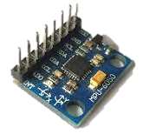
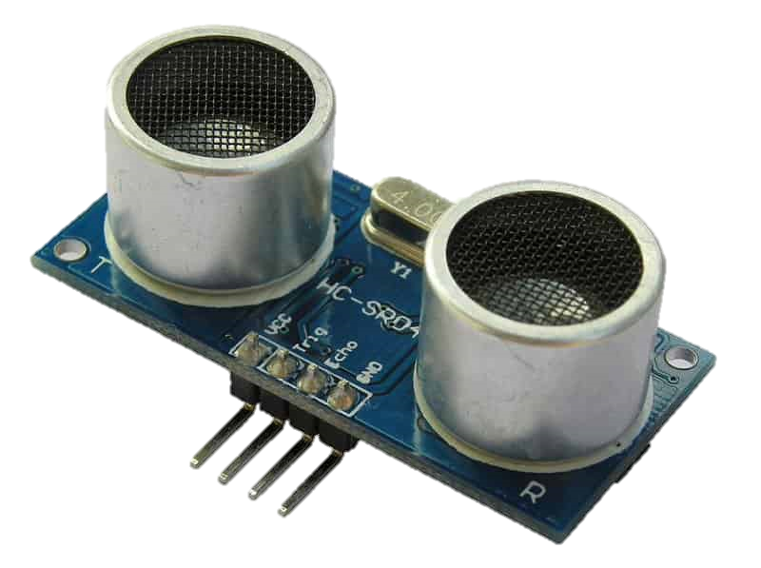
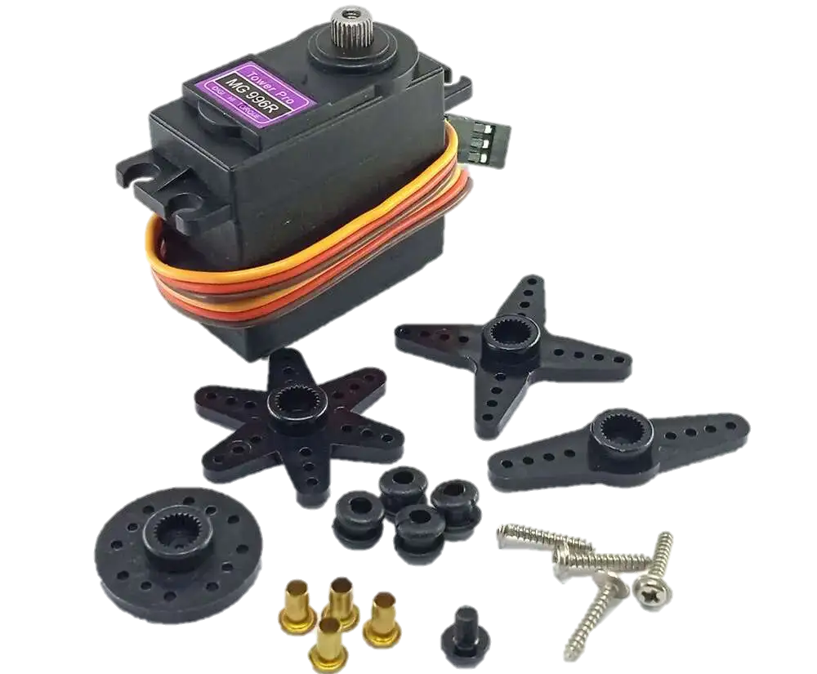
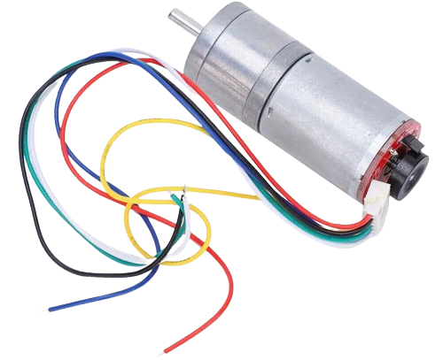
Auxiliary Boards:
Sensors Board.
Motion Board.
Actuators’ Board.

Slide 13
Battery Management System
Protection Features:
Monitoring Features:
Overvoltage
Undervoltage
Overcurrent
Short Circuit.
Voltage of each module.
Total Current of the pack
Temperature.

Slide 14
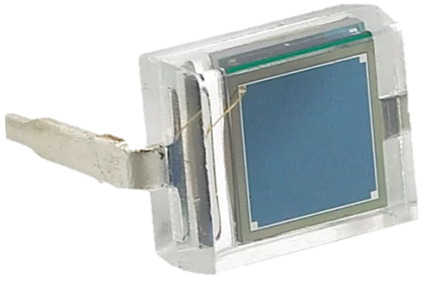
Visible Light Communication [VLC]
Transmitter
Receiver
A code is assigned to each region.
Controlled by a 220VAC LED
Each Bit maps to a certain received intensity.
Transimpedance Amplifier.
Voltage Amplifier.
Decision making.
BPW34 Micro solar cell

Slide 15
03
Embedded
Sensing and Control

Slide 16
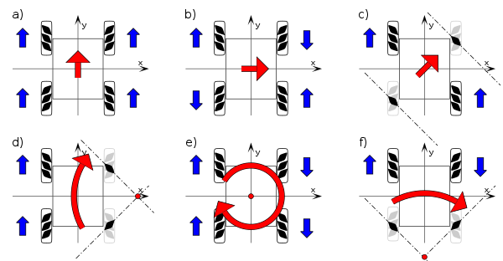
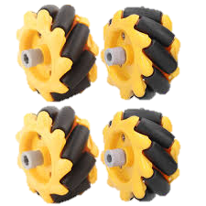
Meccanum Wheels
Enable omnidirectional movement.

Slide 17
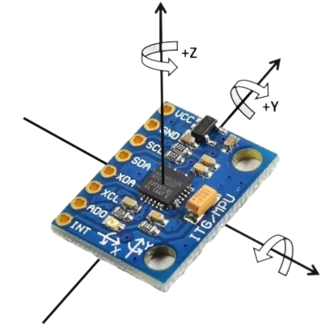
Used Sensors
IMU : MPU6050
Ultrasonic sensor

Slide 18
ROS Communication between Robot and Server
Sensors Board
Motors Board

Slide 19
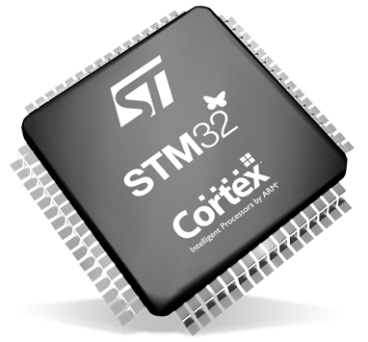
STM32 Microcontroller
Why STM32?
Key Benefit
Designed for high-performance yet low-cost applications.
Balances performance and cost for diverse device integration.

Slide 20
Thank You

